Slide 1

The Optimist Club of Evansville –
Downtown

Slide 2
Birth of our optimist club
On Friday, May 13, 1921 the Optimist Club of Evansville was chartered. The date of Friday the 13th was not picked because of their optimism, but because it was the birthday of the first club president, Dr. Charles Hartloff.
There were 34 charter members who met at the Vendome Hotel to organize the club.

Slide 3
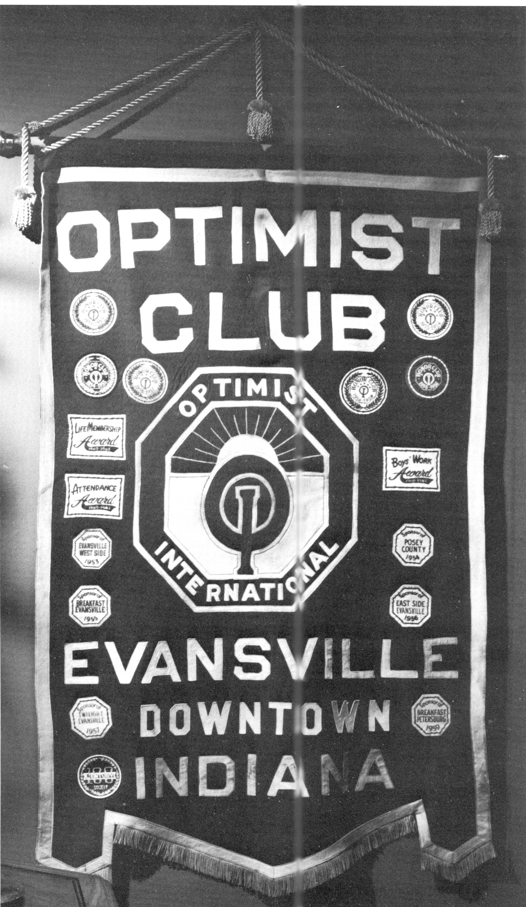
Original Optimist Banner

Slide 4
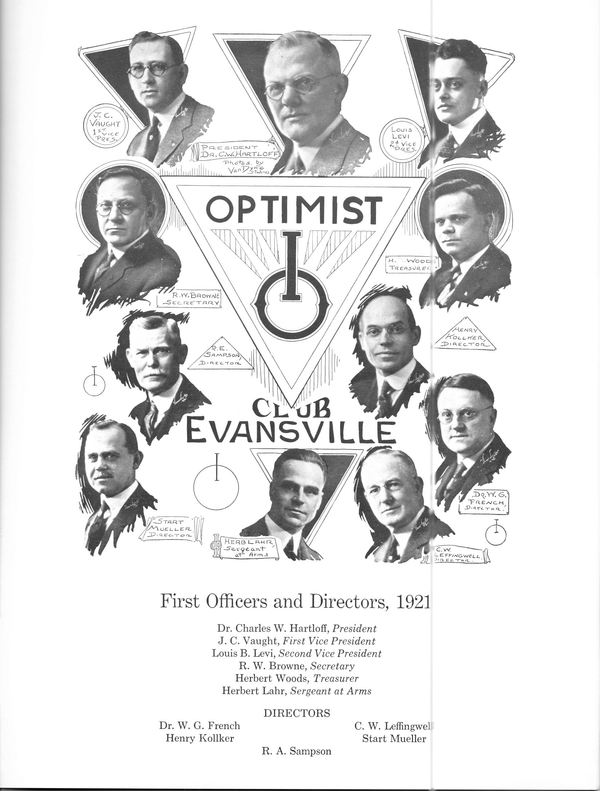

Slide 5
HIGHLIGHTS – ROARING ‘20s 1921 – 1930
Summer, 1923
At the Chattanooga International Convention, Dr. Charles Hartloff made the motion, which was passed, that the slogan of Optimism be, “Friend of the Delinquent Boy.” At the Milwaukee Convention the following year, this was changed to, “Friend of the boy”. (It has evolved to, “Friend of Youth” today.)
April, 1930
Meeting place was moved to the Vendome Hotel
May, 1930
Memorial Day Services at the graves of our departed Optimist members were started. At this date, four members have died: Rev. W. R. Plumber, Ray Geupel, Floyd Ragland, and Dr. George Ridgeway. From this date, these Services have been conducted annually under the leadership of Rev. Addison, Chaplin, as long as he lived. The tradition is still being continued.
October, 1930
Begin the sponsorship of the four Friendly Indian Junior Optimist Clubs with membership not to exceed 80 boys.

Slide 6
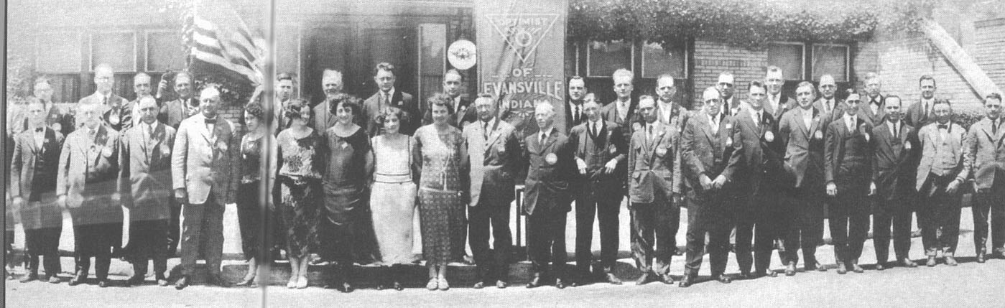
Downtown Optimist Club 1921s

Slide 7
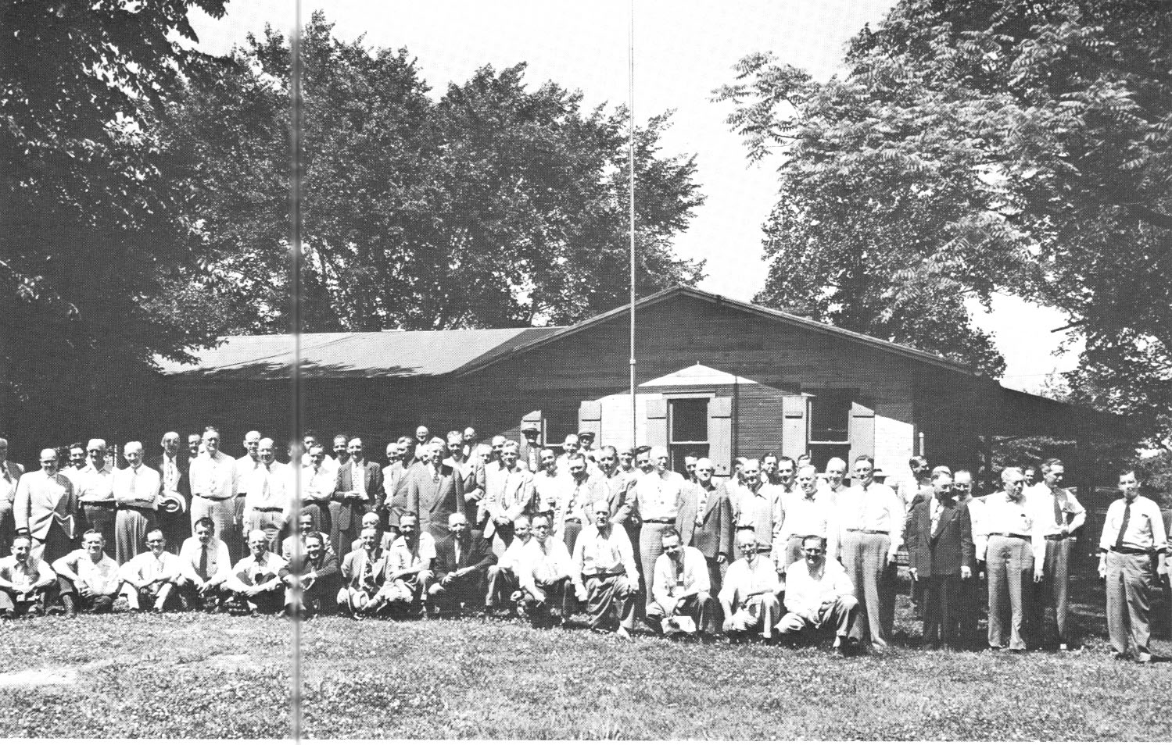
‘30s SOMETHING 1931 – 1940 Continued
Camp Optimist
October 1933
Decided to operate Camp Optimist and make it available to groups under proper supervision.
October 1934
Meeting place was moved back to Shrine Mosque.
January, 1935
Meeting place was changed to the McCurdy Hotel at 12:15 P.M. on Wednesdays.
Started first JOOI Club June 23, 1935
July, 1936
Life Membership Plan in Optimist International was opened up and the following year, George Krauss became our first life member..
August. 1937
An additional room was built at Camp Optimist at a cost of $385, the labor was done by members
Summer 1940
Searched for a new camp site, but was informed later in the year by the City Park Board they would extend the lease indefinitely so long as the Camp was used for youth work.
Note: (May, 2011) Optimist Drive still exists off Mt. Auburn

Slide 8
FLIRTATIOUS ‘40s 1941 - 1950
May, 1941
Spent $400 for the construction and furnishing of a cabin at the Y.M.C.A (Camp) Carson.
September 28, 1944
Mayor Manson Reichert declared the week Optimist week and urged all citizens to give sincere consideration to this timely appeal to the end that torment may be lifted from men’s hearts and peace may come for all nations and peoples. The theme of the observance, sponsored by Optimist clubs of the United States, Canada and Puerto Rico is Let’s be worthy of their sacrifice. This is a concerted appeal to all individuals and groups to forget differences of the past and unite in home front work for victory and lasting peace.
December, 21, 1944
Optimists hear Bosse Singers under the direction of Charles Horn.
February 14, 1945
Optimist told youth guidance is vital to nation. The youth of America is the is the greatest asset of greatest liability depending upon the guidance and education WE MAKE AVAILABLE.
May 15, 1945
Evansville Optimist Club celebrates 25th Anniversary and two charter members still present, Louis B. Levi, life Insurance and Orla Heim, Printer. Photo carried in Evansville Courier April 14, 1946. Celebration held in Gold Room of McCurdy Hotel. The work of the club started in the loft of the two story barn in back of St. Vincent’s Nursery in co-operation with the Knights of Columbus. The loft was turned into a workshop and boys from Fulton and Carpenter School districts used woodworking tools to make useful articles.

Slide 9
FLIRTATIOUS ‘40s 1941 – 1950 Continued
June 1, 1947
Articles of Incorporation filed with county recorder’s office.
Summer, 1947
Camp Optimist was remodeled and enlarged.
August, 1949
Additional funds were spent at the Camp to make the necessary changes and provide equipment for use by crippled children during the Summer months.

Slide 10
FABULOUS ’50s 1951 - 1960
October 10, 1953
Louis J. Alber, famous lecturer, world traveler and author will speak at the Optimist Club. His topic, “Laughing with World Celebrities. During World War I, Alber was national director of the speaking campaign for Liberty loans, and was past director of the National Housing Committee.
Evansville Breakfast Club met at Fritz Belvedere Café at 7 a.m.; each Tuesday.
Sponsored and established the following Optimist Clubs
March 18, 1953
March 22, 1957
Evansville West Side Club
Evansville Twilight Club
April, 1954
June, 1959
Posey County Club
Petersburg Breakfast Club
March 26, 1955
Additional Clubs established later:
Evansville Breakfast Club
May 3, 1971
Santa Claus Club
April 7, 1956
April , 1989
Evansville East Side Club
Mt. Vernon Club
May, 1956 Host to the Fifth District Convention

Slide 11
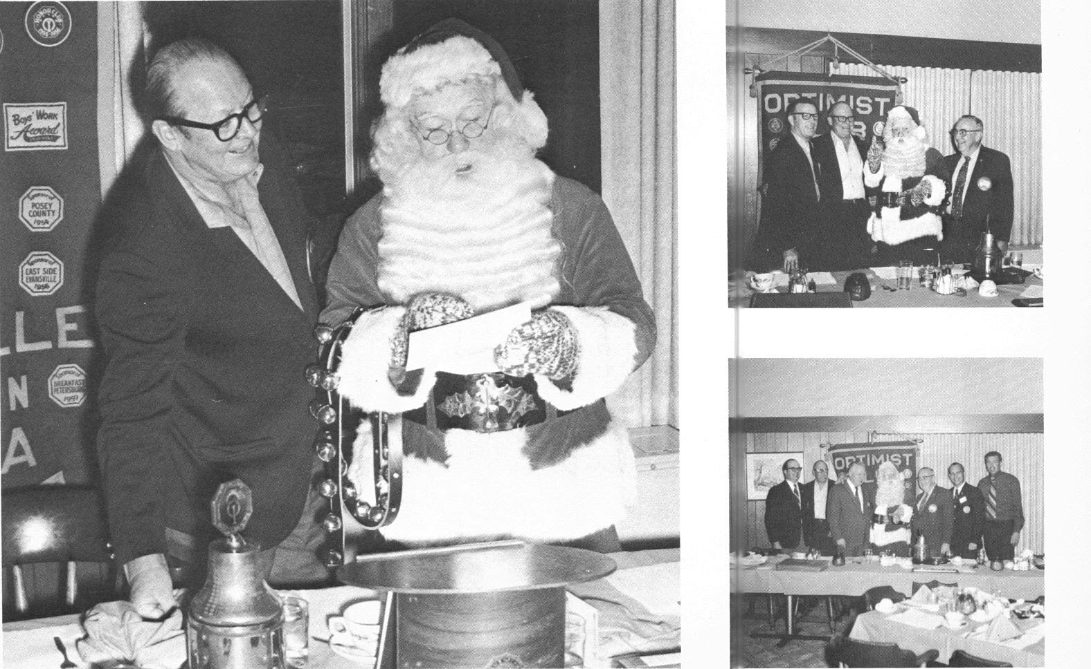
Sponsored the New Santa Claus Club

Slide 12
‘60s and ‘70s, TWO DECADES OF SERVICE 1961 – 1980
May, 1962
Host to the Fifth District Convention.
December, 1962
New set of Bylaws for the Club was adopted.
Sponsored appearance of St. Olaf Choir in Evansville
1967
Purchased diorama for permanent installation at Evansville Museum of Arts and Sciences.
1968
Paved play area in Wheeler school area for youth recreation purposes.
Returned Camp Optimist to the City of Evansville Parks Department.
1969
Meeting place moved from Hotel McCurdy to Hadi Shrine. Participated in purchase of materials including films for Evansville Police Department “Respect for Law” Program.
Formed Junior Optimist Outdoor Club.
1970
Formed outdoor Junior Optimist Club.
Sponsored Pass, Shoot Dribble Basketball Contest, taking our local winner to Rushville, Indiana for state competition. Purchased tape recorder cassettes for Evansville Police Department. Contributed to bring stage presentation “Concept” to Evansville in cooperating effort with Junior Service League’s work against drug abuse.

Slide 13
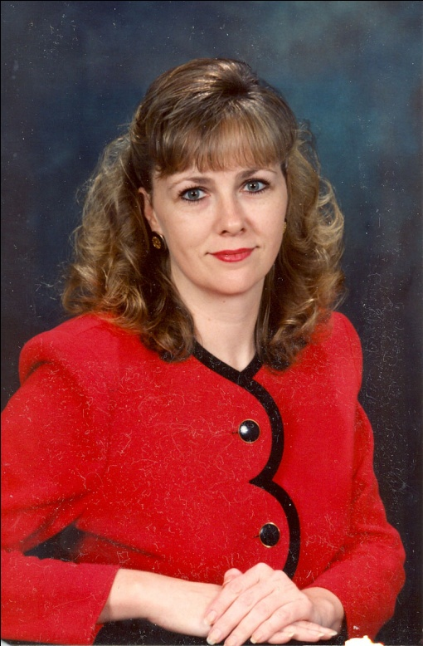
Optimists clubs changed forever
WOMEN JOIN THE RANKS TO HELP KIDS
A number of members, male members, did not like the idea of women joining their all male club. The women had their own club,
Time would prove these disgruntled males to be in the minority and very wrong. We know today that without the women, many leaders, Optimists would not be a viable entity. Today, women make up eighteen percent of our club, and since 1992, there have been seven women presidents.
Pam Fulkerson-Macer was the first woman in the club when she joined on March 1, 1988.
President , 1992 – 1993

Slide 14
Optimists clubs changed forever - Continued
WOMEN PRESIDENTS
Pam Macer
Virginia (Ginger) Drake
Lana Baker
Peggy Bakel
Betty Strickland
Marilyn Robinson
Karen Morris
1992 – 1993
1994 – 1995
1996 – 1997
2002 – 2003
2003 – 2004
2006 – 2007
2008 – 2009
Currently, 24 percent of the Club is comprised of women. Where would we be without them?

Slide 15


‘80s to ‘2017s, SERVICE INTO THE NEXT CENTURY
April 14, 1989
Built Mt. Vernon Club
August 2000
Hosted the District’s 14th Convention
April 16,, 2001
Built Culver School JOOI Club
October 21, 2002
Built Warrick County Club
October 27, 2007
Built Evansville North Side Club
August 2007
Hosted the District’s 21st Convention
January 24, 2008
Built Joshua Academy JOOI Club

Slide 16
Past Presidents Still Active in the Club
Donald Julian 1986 - 1987
Ronald P. Eberhart 1987 - 1988
Timothy Deisher 1989 - 1990
Kenneth Dennis 1993 - 1994
Gary Burk 1997 - 1998
Todd Wahl 1998 - 1999
Michael Wall 2005 - 2006
Donald Julian 2007 - 2008
Karen Morris 2008 - 2009
Ronald P. Eberhart 2009 - 2010
Jeff Olson 2013 - 2014
John Perkins 2016 – 2017
Current President

Slide 17
DISTRICT OFFICERS FROM EVANSVILLE
Past Governors
1947-1948 *Olive C. Reeves, Evansville
1949-1950 *Paul E. Miller, Evansville
1955-1956 *William E. Laswell, Evansville
1959-1960 *Gordon "Bish" S. Thompson, Evansville
1975-1976
*Daniel M. Kissel, Evansville Downtown
Past District Secretary Treasurers
2006-09 Gary A. Burk, Evansville

Slide 18
DISTRICT OFFICERS FROM EVANSVILLE -
Continued
Past Lieutenant Governors
In Alphabetical Order
Gary Burk
Ron Eberhart
Ken Dennis
Tim Deisher
Don Julian
Dan Kissel
William Laswell
Paul E. Miller
Ollie Reeves
Betty Strickland
Gordon ”Bish” Thompson

Slide 19
NATIONAL HIGHLIGHTS
DURING OUR CLUBS HISTORY
Pages of Time - A Nostalgia News Report - Selected Years in Review
 | 1921 Prices | 1931 Prices | 1941 Prices | 1951 Prices | 1961 Prices | 1971 Prices | 1981 Prices | 1991 Prices | 2011 Prices
Average Income | $2,134.00 | $1,858.00 | $1,777.00 | $3,515.00 | $5,215.00 | $10,622.00 | $21,073.00 | $29,943.00 | $46,326.00
New Car | $420.00 | $640.00 | $850.00 | $1,520.00 | $2,849.00 | $3,560.00 | $7,718.00 | $16,850.00 | $28,400.00
New House | $7,019.00 | $6,796.00 | $4,075.00 | $9,000.00 | $12,550.00 | $25,200.00 | $78,220.00 | $120,000.00 | $185,475.00
Loaf of Bread | $0.10 | $0.08 | $0.08 | $0.16 | $0.21 | $0.25 | $0.53 | $0.72 | $2.79
Gallon of Gas | $0.11 | $0.10 | $0.12 | $0.19 | $0.27 | $0.40 | $1.31 | $1.12 | $3.10
Gallon of Milk | $0.58 | $0.50 | $0.54 | $0.92 | $1.05 | $1.17 | $2.23 | $2.80 | $3.50
Gold Per Ounce | $20.67 | $20.67 | $35.00 | $35.00 | $35.00 | $41.25 | $459.64 | $363.29 | $1,348.31
Silver Per Ounce | $1.09 | $0.38 | $0.71 | $0.90 | $0.92 | $1.54 | $10.48 | $4.04 | $27.53
Dow Jones Average | $73.00 | 138.00 | 121.00 | 257.00 | 672.00 | 884.00 | 932.00 | 2,819.57 | 11,872.00
Minimum Wage | NONE | NONE | NONE | NONE | $1.15 | $1.60 | $3.35 | $4.25 | $7.25
Life Expectancy | 54.1 | 59.7 | 62.9 | 68.2 | 69.7 | 71.1 | 74.2 | 75.5 | 77.5

Slide 20
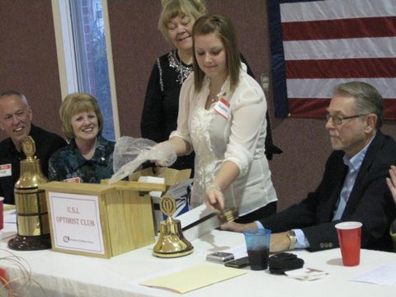
New Club Chartered on April 2, 2011
U.S.I. Optimist Club
Charter Party
President of the USI Optimist Club, Stephanie Kreilein, ringing the bell for the first time.
Pictured left to right: Kent and Paula Reyling, Betty Strickland, Indiana South District Lt. Governor, Stephanie, and Ron Eberhart, Downtown Optimist President and New Club Organizer.

Slide 21
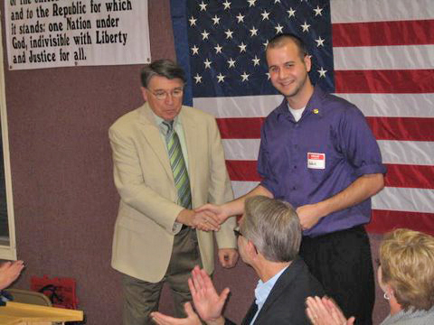
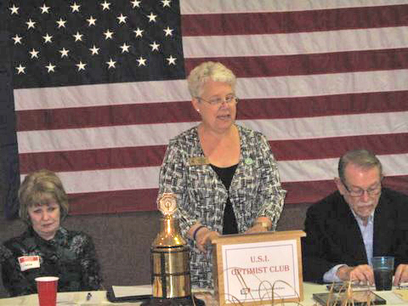
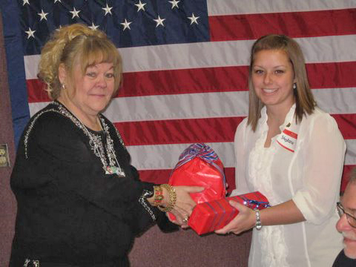
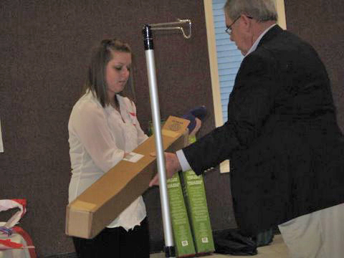
New Club Chartered on April 2, 2011 - Con’t
Ken Dennis, President of the Downtown Optimist Club Foundation, presented Nathan Messmer, Treasurer of the USI club, with a check for $500.
Governor Kathy Underwood addresses the USI Optimist Club during their Charter Banquet.
Lt. Governor, Betty Strickland, presents the USI club president, Stephanie Kreilein with their club bell and gavel .
Jerry Schue presents Stephanie Kreilein with a banner stand to hold their "creed".

Slide 22
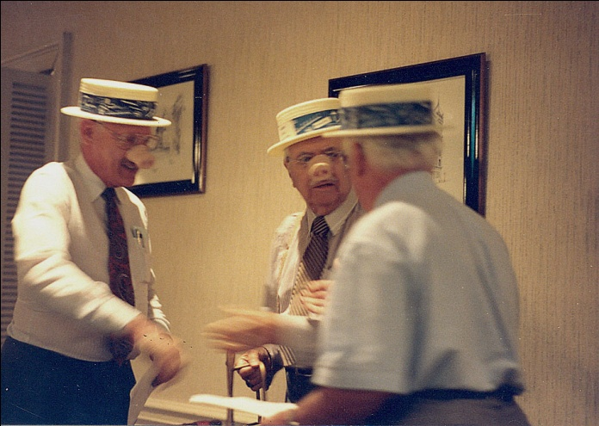
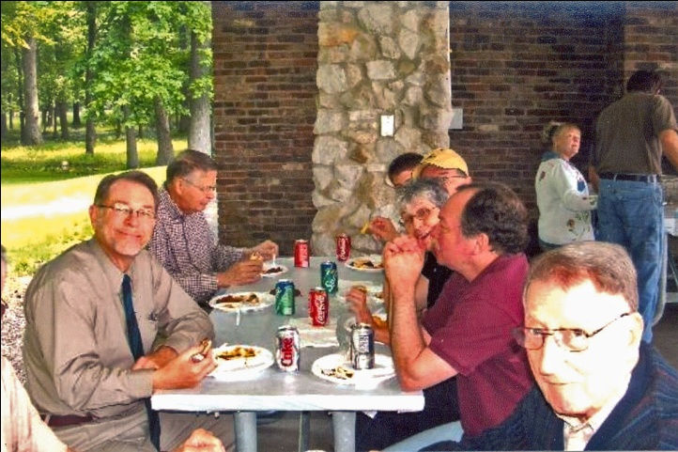
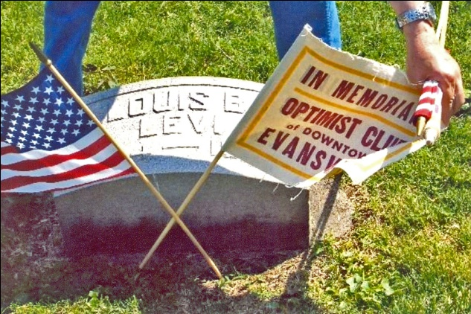
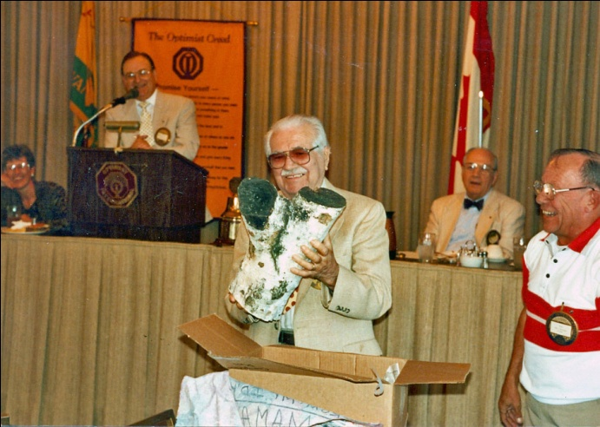
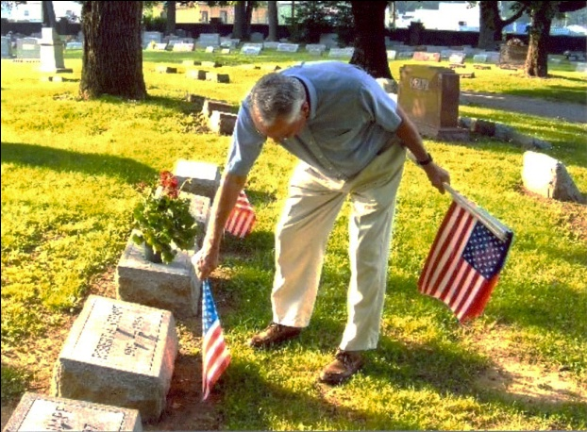
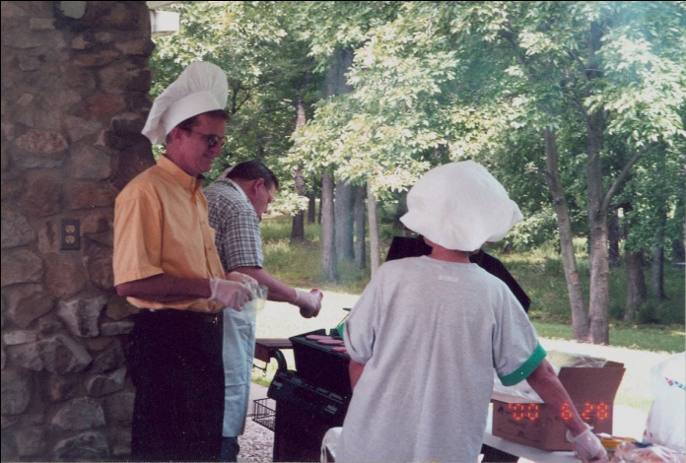
CLUB Events
Changing of the Guard
Memorial Day Grave Visitation
Annual Picnic
Henry Ballman adding to his Woodpecker Hole collection

Slide 23

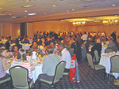
Events with the Kids
Joshua Academy
Junior Optimist Club
Youth Appreciation Breakfast

Slide 24
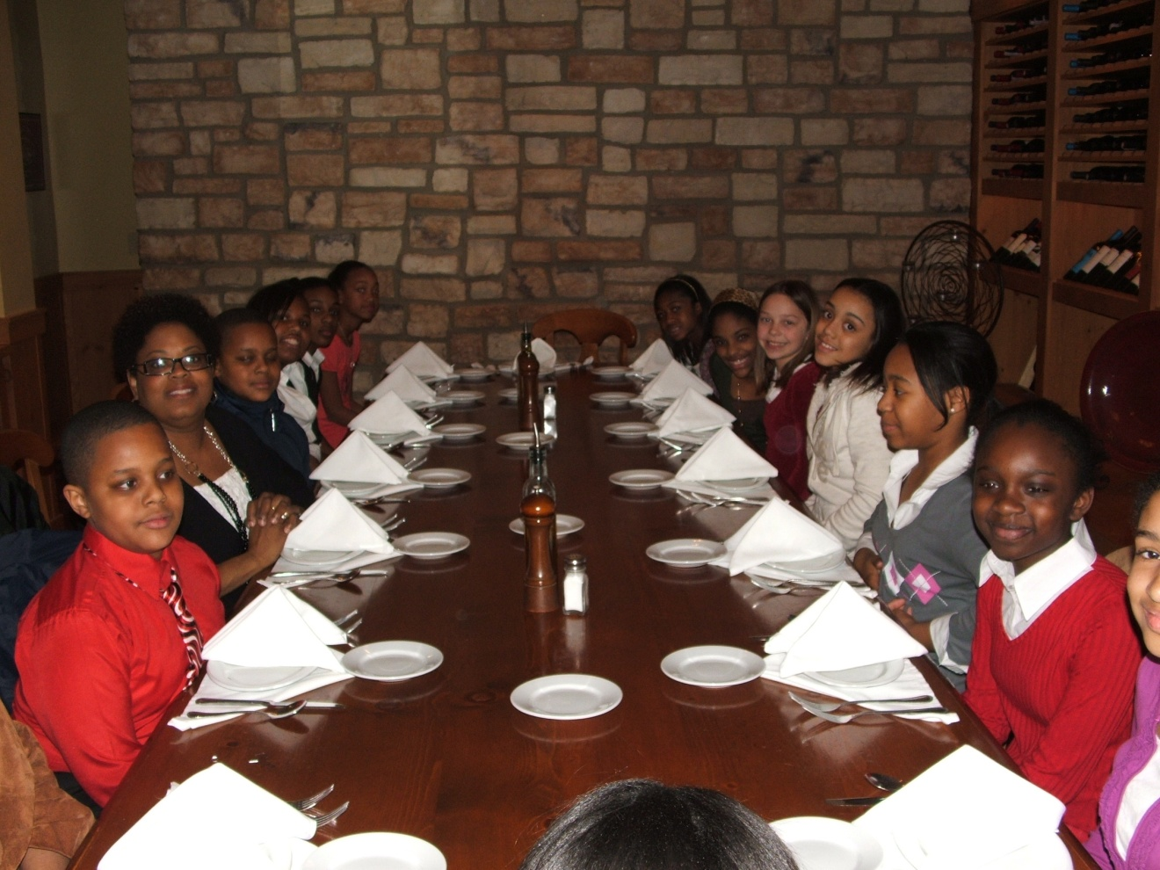
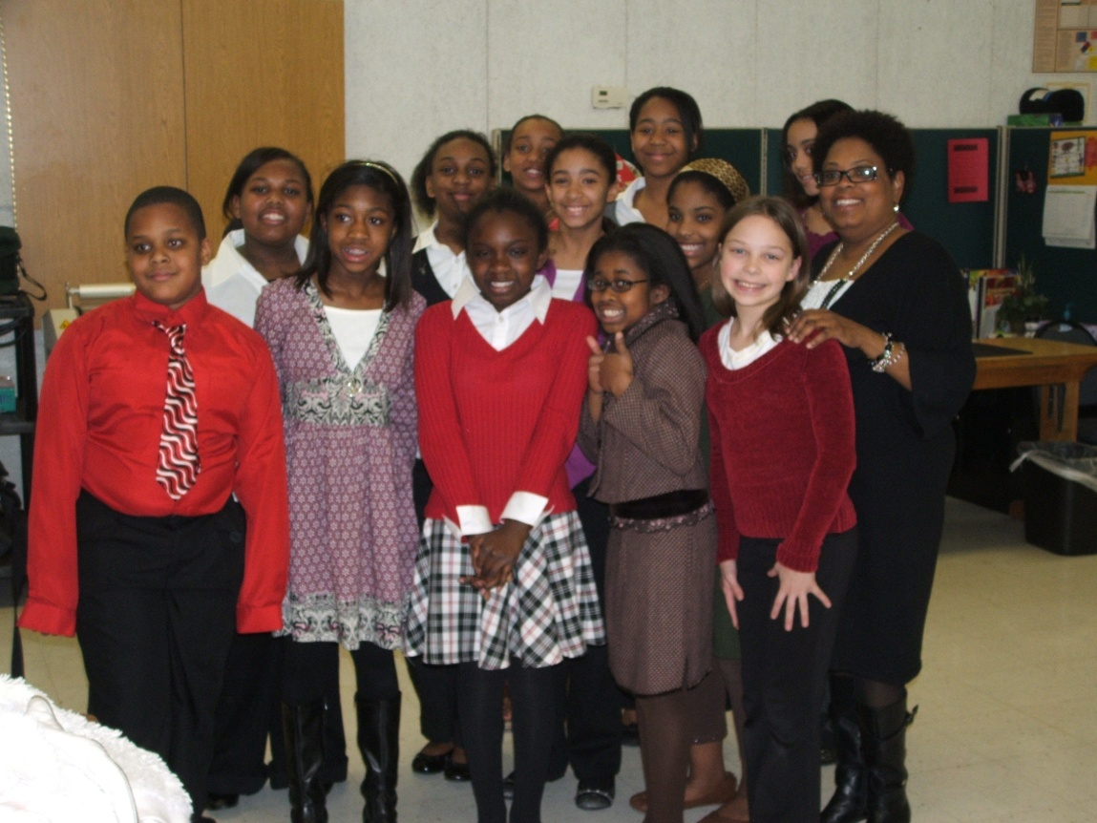
Kids at Biaggi’s Restaronte Italiano after their “Dinner Etiquette Class
Our outing was rained out, so we went to Lic’s Ice Cream.

Slide 25

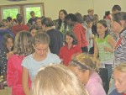
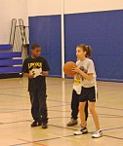

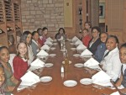
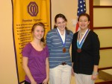

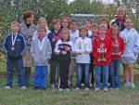
Junior Optimist Club
Camp Carson Dinning Room
Tri-Star Basketball
Camp Carson
Joshua Academy – JOOI After the Dinning Etiquette Class
Oratorical Winners
Tri-Star Basketball
Soccer Winners

Slide 26
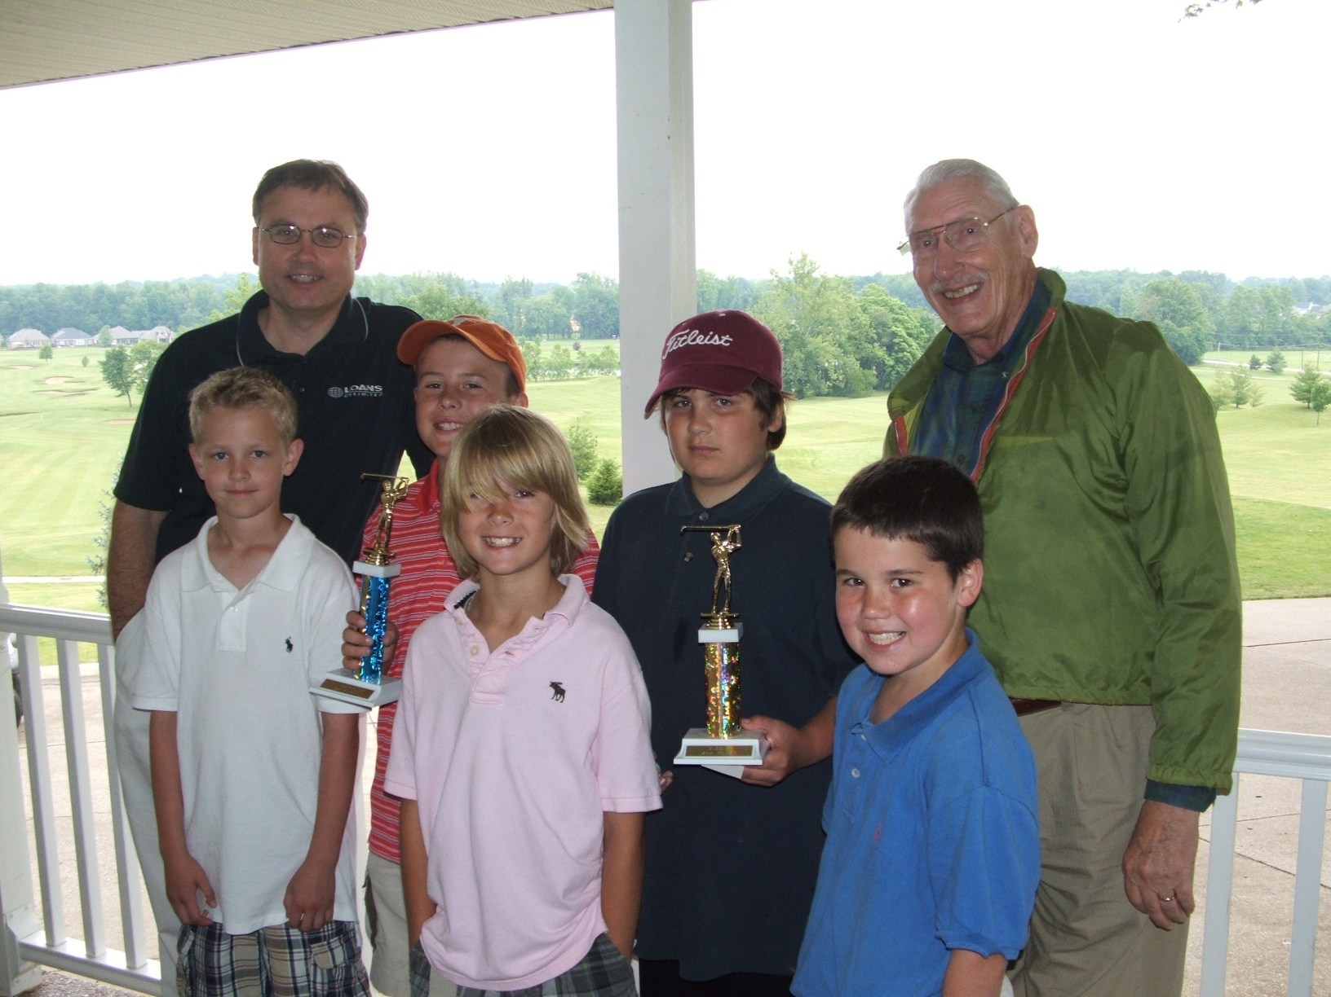
Dan Phillips and Don Julian with the Junior Golf WINNERS!

Slide 27
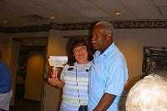
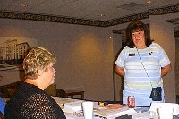
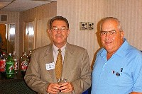
Something is not on the Level

Slide 28
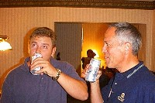
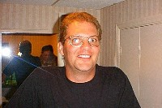
Like I said. . .

Slide 29
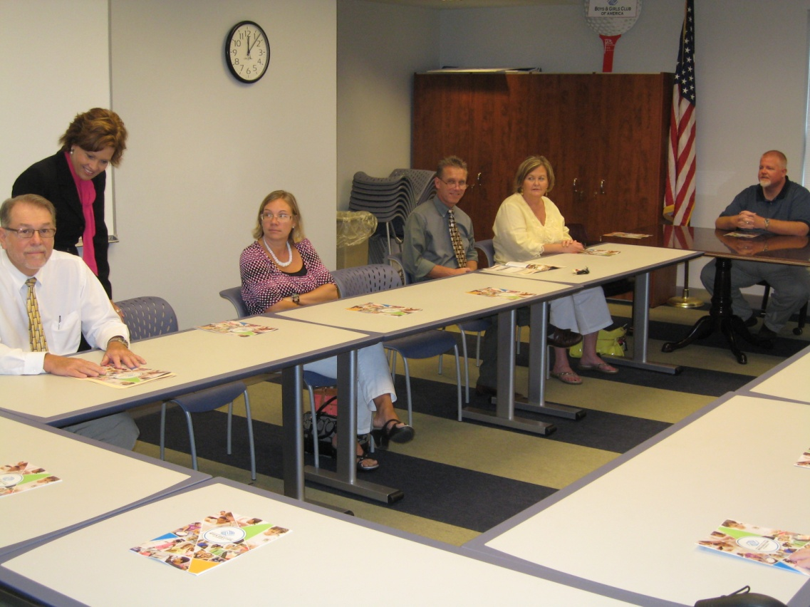
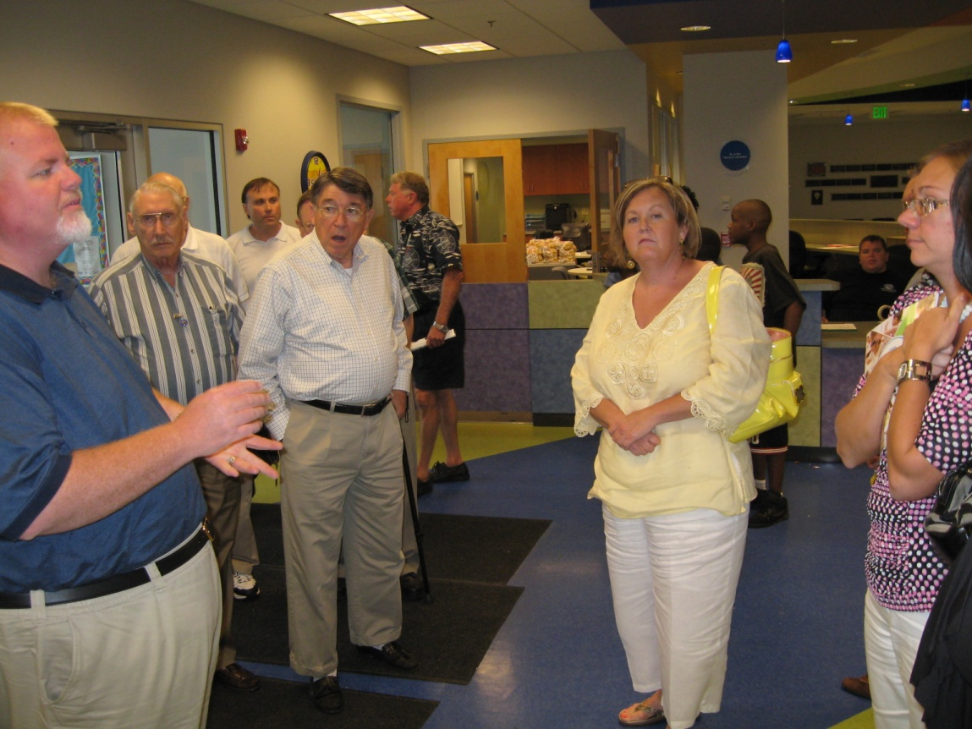
Board Meeting at the “Boys and Girls Club”
Getting the $500 Tour

Slide 30
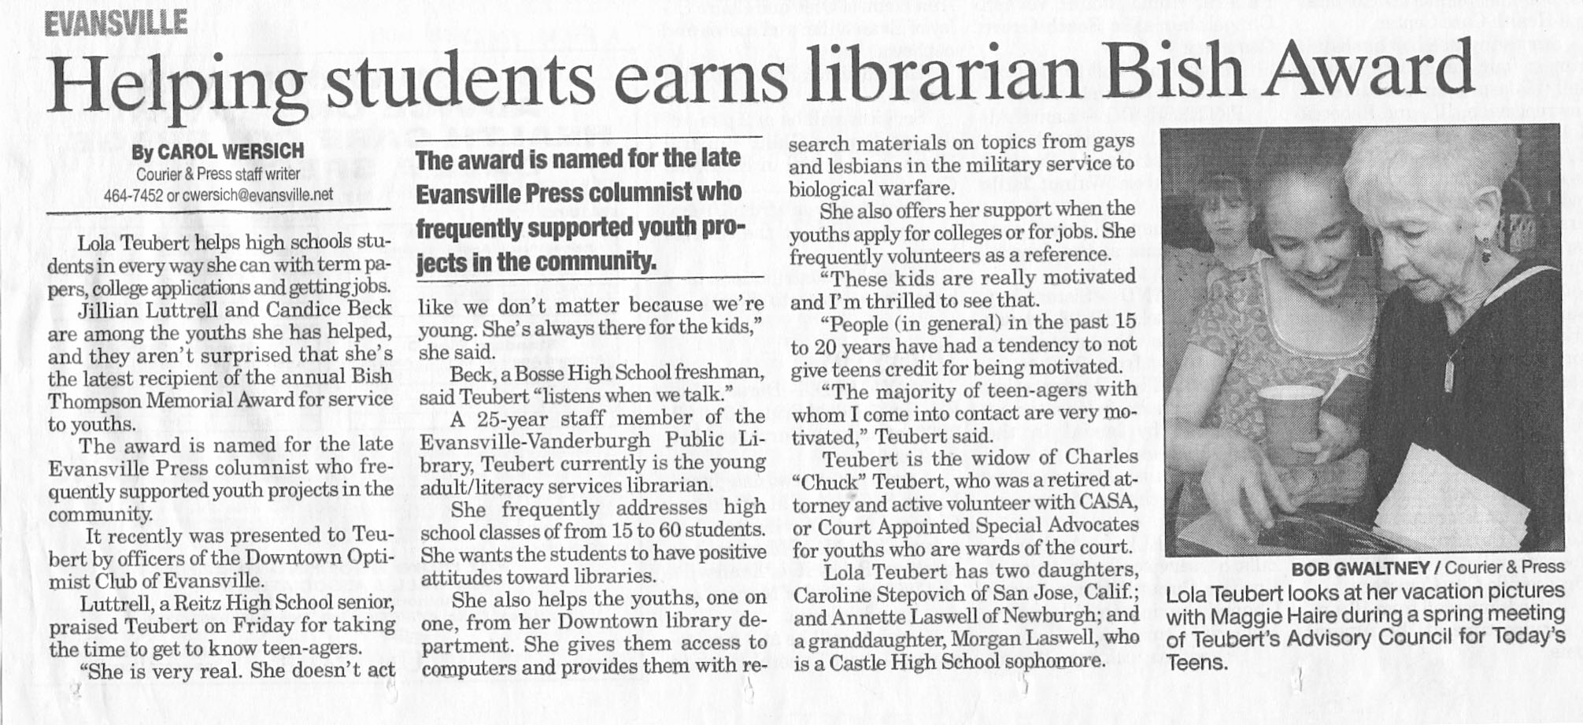
Award Given to people who help kids. – Bish Thompson wrote, “Of Dreams and Deeds.” He was an International Vice President at OI.

Slide 31
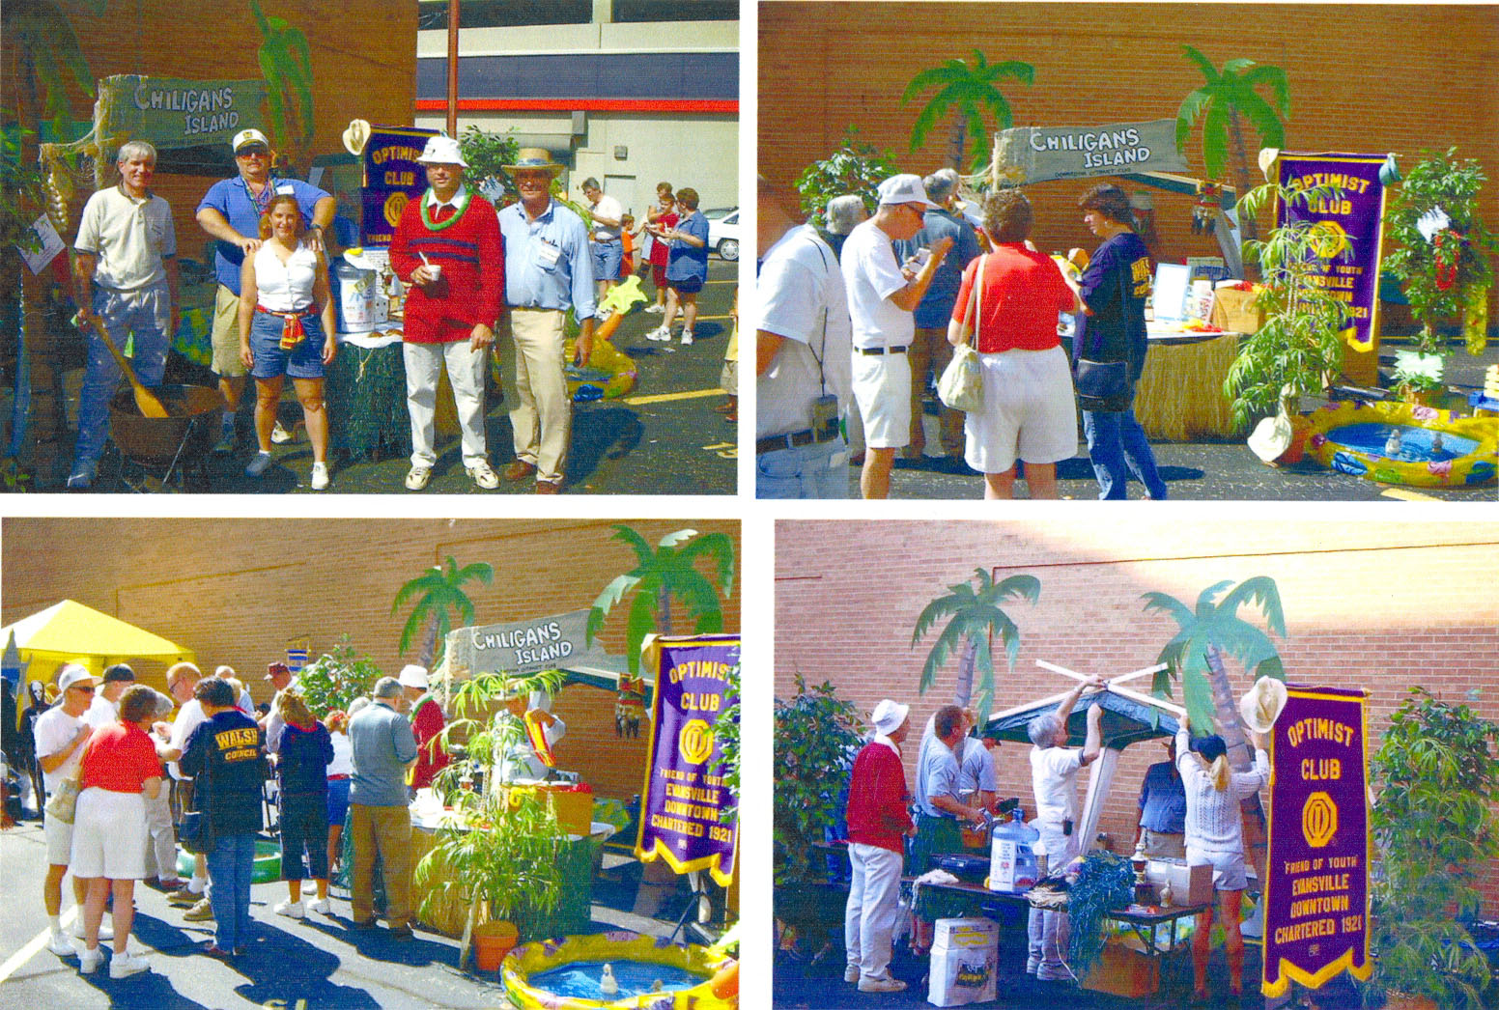
Chiligan’s Island – Chili Cook-off at the Freedom Festival

Slide 32
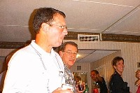
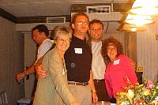

Slide 33
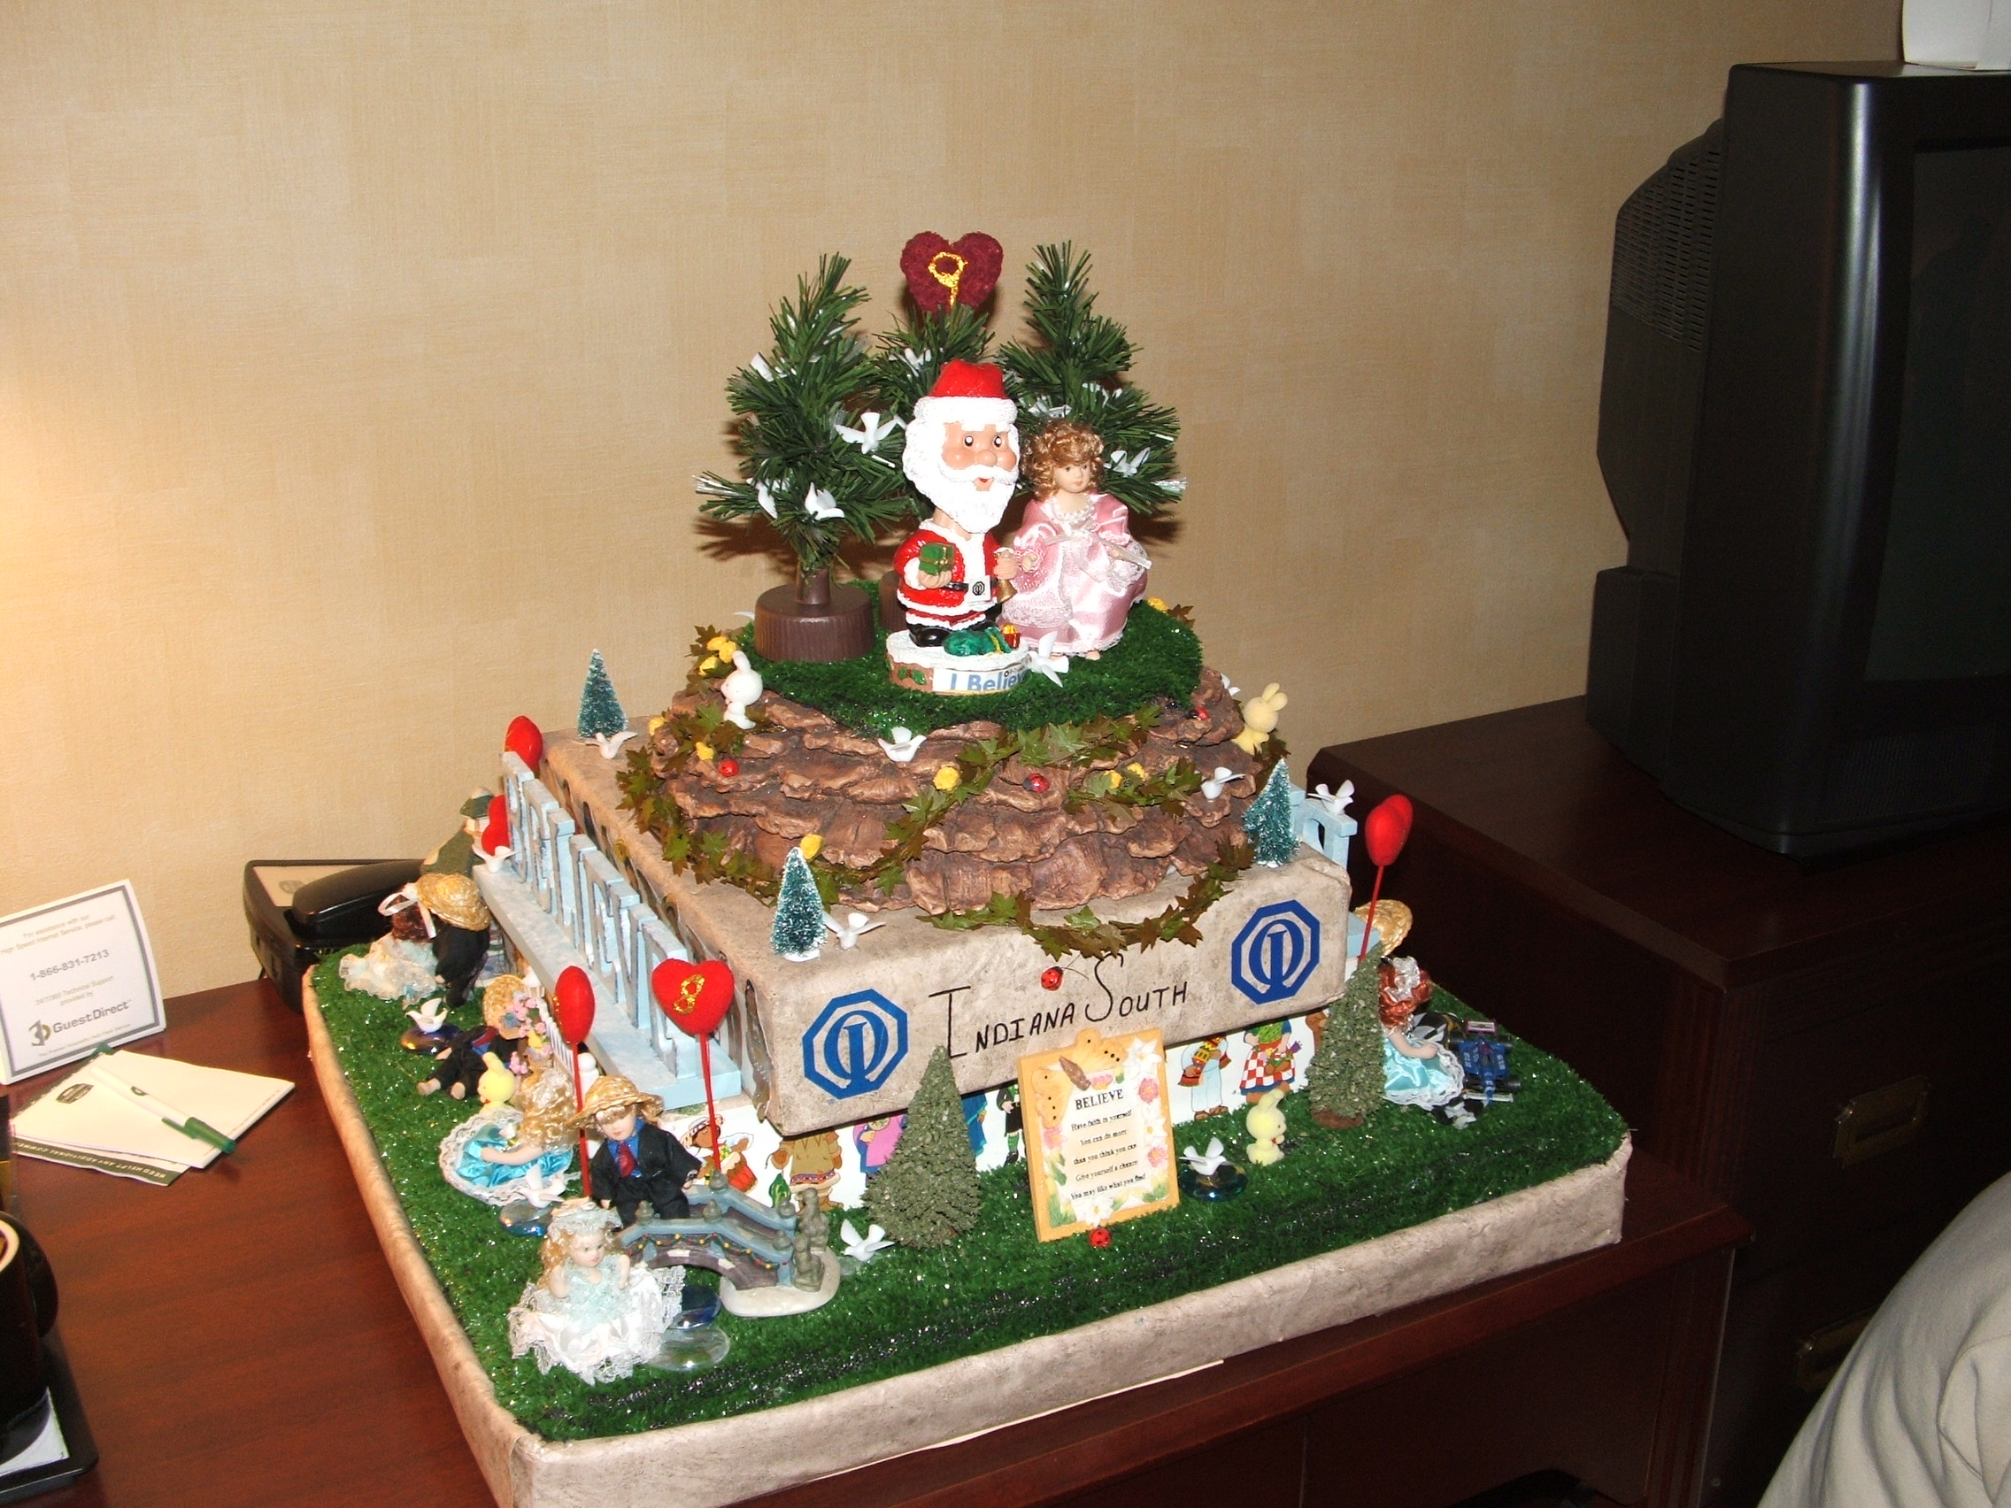
One of Betty Strickland’s creations.
She was a great Optimist!

Slide 34
THE OPTIMIST CREED
Promise Yourself . . .
To be so strong that nothing can disturb your peace of mind.
To talk health, happiness and prosperity to everyone you meet.
To make all your friends feel that there is something in them.
To look at the sunny side of everything and make your optimism come true.
To think only the best, to work only for the best and expect only the best.
To be just as enthusiastic about the success of others as you are about your own.
To forget the mistakes of the past and press on to the greater achievements of the future.
To wear a cheerful countenance at all times and give every living creature a smile.
To give so much time to the improvement of yourself that you have no time to criticize others.
To be too large for worry, too noble for anger, too strong for fear, and too happy to permit the presence of trouble.

Slide 35

OPTIMISTISM IS A WAY OF LIFE-BELIEVE

